Slide 1
Distributed Objects and Remote Invocation
UNIT-2

Slide 2
Distributed Objects and Remote Invocation
Topics covered in this chapter:
Communication between distributed objects
Remote procedure call
Events and notification
Java RMI
What are issues in distributing objects?
How can we identify objects?
What is involved in invoking a method implemented by the class?
What methods are available?
How can we pass parameters and get results?
Can we track events in a distributed system?
Instructor’s Guide for Coulouris, Dollimore and Kindberg Distributed Systems: Concepts and Design Edn. 3 © Addison-Wesley Publishers 2000

Slide 3
Programming Models for Distributed Application
Remote procedure call – client calls the procedures in a server program that is running in a different process
Remote method invocation (RMI) – an object in one process can invoke methods of objects in another process
Event notification – objects receive notification of events at other objects for which they have registered
These mechanism must be location-transparent.
Instructor’s Guide for Coulouris, Dollimore and Kindberg Distributed Systems: Concepts and Design Edn. 3 © Addison-Wesley Publishers 2000

Slide 4
Middleware
Middleware Roles
provide high-level abstractions such as RMI
enable location transparency
free from specifics of
communication protocols
operating systems and communication hardware
interoperability
Instructor’s Guide for Coulouris, Dollimore and Kindberg Distributed Systems: Concepts and Design Edn. 3 © Addison-Wesley Publishers 2000

Slide 5
Location transparency:hide the location (Whether the procedure runs in same process or other process)
comm’n protocols:protocols are independent of underlying transport protocols eg:request-reply protocol can be implemented over UDP/TCP
OS:higher level abstractions provided by Middle ware are independent of underlying OS.
Comp H/W:external data representation,marshaling and unmarshaling.hide the differences due to h/w architectures
Use of programing lang:middle ware is designed to alloew dis applications to use more than one programming lang(IDL)
Instructor’s Guide for Coulouris, Dollimore and Kindberg Distributed Systems: Concepts and Design Edn. 3 © Addison-Wesley Publishers 2000

Slide 6
Figure 5.1 Middleware layers
Applications
RMI, RPC and events
Middleware
Request reply protocol
layers
External data representation
Operating System
Instructor’s Guide for Coulouris, Dollimore and Kindberg Distributed Systems: Concepts and Design Edn. 3 © Addison-Wesley Publishers 2000

Slide 7
Interfaces
Interface – skeleton of public class
Comm’n blw modules can be by means of procedure calls b/w modules to control possible interactions explicit interface is defined
Interaction specification
useful abstraction that removes dependencies on internal details
Examples
procedure interface
class interface
Module interface
Interfaces in Distributed sys:It is not possible for amodule running in one process to access the variables in amodule in another process
The specification of aprocedure or method in the interface of amodule describes parameters as input and output parameters
Input parameters:they are passed to remote module by sending the values of the arguments in the request mesz
Output parameters:they are returned in reply mesz and are used as result for call
Instructor’s Guide for Coulouris, Dollimore and Kindberg Distributed Systems: Concepts and Design Edn. 3 © Addison-Wesley Publishers 2000

Slide 8
Service interface
specifies set of procedures available to client
input and output parameters
Remote Procedure Call
arguments are marshaled
marshaled packet sent to server
server unmarshals packet, performs procedure, and sends marshaled return packet to client
client unmarshals the return
all the details are transparent
Instructor’s Guide for Coulouris, Dollimore and Kindberg Distributed Systems: Concepts and Design Edn. 3 © Addison-Wesley Publishers 2000

Slide 9
Remote interface
specifies methods of an object available for remote invocation
input and output parameters may be objects
Remote Method Invocation
communication actual arguments marshaled and sent to server
server unmarshals packet, performs procedure, and sends marshaled return packet to caller
client unmarshals return packet
common format definition for how to pass objects (e.g., CORBA IDL or Java RMI)
Instructor’s Guide for Coulouris, Dollimore and Kindberg Distributed Systems: Concepts and Design Edn. 3 © Addison-Wesley Publishers 2000

Slide 10
Interface Definition Language:they are designed to allow objs implemented in different languages to invoke one another
notation for language independent interfaces
specify type and
kind of parameters
examples
CORBA IDL for RMI
Sun XDR for RPC
DCOM IDL
IDL compiler allows interoperability
Instructor’s Guide for Coulouris, Dollimore and Kindberg Distributed Systems: Concepts and Design Edn. 3 © Addison-Wesley Publishers 2000

Slide 11
CORBA IDL Example
struct Person {
string name;
string place;
long year;
} ;
interface PersonList {
readonly attribute string listname;
void addPerson(in Person p) ;
void getPerson(in string name, out Person p);
long number();
};
Figure 5.2
CORBA has a struct
remote interface
remote interface defines methods for RMI
parameters are in, out or inout
Remote interface:
specifies the methods of an object available for remote invocation
an interface definition language (or IDL) is used to specify remote interfaces. E.g. the above in CORBA IDL.
Java RMI would have a class for Person, but CORBA has a struct
•
Instructor’s Guide for Coulouris, Dollimore and Kindberg Distributed Systems: Concepts and Design Edn. 3 © Addison-Wesley Publishers 2000

Slide 12
5.2 COMM’N B/W DISTRIBUTED OBJECTS
The object based model for a distributed system extends the model supported by oop languages to make it apply to distributed objects.the material is provided under the following headings
The object model
Distributed obj
The Distributed obj model
Design issues
Implementation
Distributed garbage collection
Instructor’s Guide for Coulouris, Dollimore and Kindberg Distributed Systems: Concepts and Design Edn. 3 © Addison-Wesley Publishers 2000

Slide 13
The Object Model
An object encapsulates encapsulates both data and methods.
Object refernces:objects can be accessed via obj references.to invoke a method in an obj ,the obj reference and method name are given ,together with any necessary arguments.the obj whose method is invoked is called target/receiver
Interfaces:An interface provides a definition of the signatures of aset of methods with out specifying implementation.In java ,a class may implement several inetrfaces and methods of an interface may be implemented by any class
Instructor’s Guide for Coulouris, Dollimore and Kindberg Distributed Systems: Concepts and Design Edn. 3 © Addison-Wesley Publishers 2000

Slide 14
The Object Model
Actions:It is initiated by an invoking a method in another obj
An invocation of a method can have 3 effects
The state of receiver may change
A new obj may be instantiated
Further invocations on methods in other objs may take place
Exceptions: during the execution of a method many different problems may be discovered for ex:inconsistent values in obj varaiables,failure in attempts to read or write files .a block of code may be defined to thrown an exception ,another block of code that catches the exception when an error occurs.
Garbage collection frees the space occupied by objects when they are no longer needed
Instructor’s Guide for Coulouris, Dollimore and Kindberg Distributed Systems: Concepts and Design Edn. 3 © Addison-Wesley Publishers 2000

Slide 15
5.2.2 Distributed Objects
Distributed objs may adopt the client-server architecture ,inthis case objects are managed by servers and their clients invoke their methods using RMI
The invocation is carried out by executing a method of the obj at the server and result is returned to client in another message
To allow chain of invocations ,objects in servers are allowed to become clients of objects in other servers
Distributed objects can assume other architectural models ,objects can be replicated in order to obtain the usual benefits of fault tolerance and enhanced performance
Having client and server objects in different processes enforces encapsulation,that is the state of object can be accessed only by methods of objects but not by unauthorized methods

Slide 16
5.2.3 The Distributed Objects Model
This section discusses abt extensions of object model
Each process contain collection of objs some of which can receive both local and remote invocations ,where as others may receive only local invocations
Remote method invocation – Method invocations between objects in different processes, whether in the same computer of not.
Local method invocation – Method invocations between objects in the same process.
Remote object – Objects that can receive remote invocations.
Remote and local method invocations are shown in Figure 5.3.
Instructor’s Guide for Coulouris, Dollimore and Kindberg Distributed Systems: Concepts and Design Edn. 3 © Addison-Wesley Publishers 2000

Slide 17
Distributed Object Model
Figure 5.3
remote
local
C
invocation
invocation
local
E
invocation
remote
B
invocation
F
A
local
invocation
D
each process contains objects, some of which can receive remote invocations, others only local invocations
those that can receive remote invocations are called remote objects
objects need to know the remote object reference of an object in another process in order to invoke its methods. How do they get it?
the remote interface specifies which methods can be invoked remotely
•
Instructor’s Guide for Coulouris, Dollimore and Kindberg Distributed Systems: Concepts and Design Edn. 3 © Addison-Wesley Publishers 2000

Slide 18
Distributed Object Model
Remote object reference: A remote obj reference is an identifier that can be used throughtout dis sys to refer a unique remote obj
Remote obj are analogous to local ones
An object must have the remote object reference of an object in order to do remote invocation of an object
Remote object references may be passed as input arguments or returned as output arguments
Instructor’s Guide for Coulouris, Dollimore and Kindberg Distributed Systems: Concepts and Design Edn. 3 © Addison-Wesley Publishers 2000

Slide 19
Remote interface:the class of remote interface implements the methods of its remote interface,objs in other process invoke only the methods that belong to its remote interface
Local obj can invoke the methods in remote interface as well as other methods implemented by remote obj
The CORBA sys provides an IDL which is used for defining remote interfaces
The classes of remote objs and the client programs may be implemented in any language like c++/java/python for IDL compiler is available
The CORBA client need not use such language as the remote obj in order to invoke its methods remotely
Instructor’s Guide for Coulouris, Dollimore and Kindberg Distributed Systems: Concepts and Design Edn. 3 © Addison-Wesley Publishers 2000

Slide 20
Figure 5.4 A remote object and its remote interface
remote
object
remote
Data
interface
m4
{
m1
implementation
m2
m5
m3
of methods
m6
Instructor’s Guide for Coulouris, Dollimore and Kindberg Distributed Systems: Concepts and Design Edn. 3 © Addison-Wesley Publishers 2000

Slide 21
Actions in Dis Obj Model:
In distributed case ,the obs involved in achain of related invocations may be located in different processes
When an invocation crosses the boundary of a process it uses RMI,the remote reference of the object must be available to the invoker
From Fig 5.3The obj A needs to hold a remote obj reference to obj B, remote obj references may be obtained as the result of remote method invocation
The obj A might obtain the reference of obj F from obj B
Instructor’s Guide for Coulouris, Dollimore and Kindberg Distributed Systems: Concepts and Design Edn. 3 © Addison-Wesley Publishers 2000

Slide 22
Garbage collection in Dis Obj Model:
For eg java supports garbage collection then any associated RMI system should allow garbage collection of remote objs
Dis garbage collection is generally achieved by cooperation between local garbage collector and an added module of dis garbage collection
Exceptions:Any remote invocation may fail for reasons related to the invoked obj being in different process
For eg,obj may be crashed,too busy to reply ,result mesz may be lost
Instructor’s Guide for Coulouris, Dollimore and Kindberg Distributed Systems: Concepts and Design Edn. 3 © Addison-Wesley Publishers 2000

Slide 23
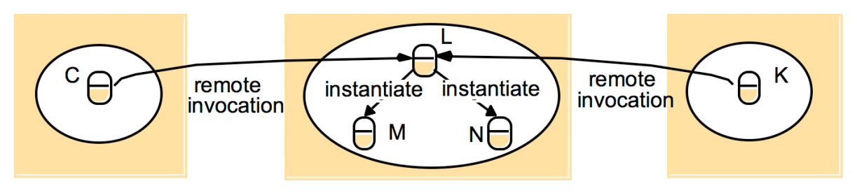
When an action leads to the instantiation of a new object, that object will normally live within the process where the instantiation is requested.
If a newly instantiated object has a remote interface, it will be a remote object with a remote object reference.
Instructor’s Guide for Coulouris, Dollimore and Kindberg Distributed Systems: Concepts and Design Edn. 3 © Addison-Wesley Publishers 2000

Slide 24
5.2.4 Design Issues for RMI
RMI is a natural extension of local Invocation: (These problems won’t occur in the local invocation.)
We discuss two designs issues that arise making this extension
The choice of invocation semantics-Number of times of invocations are invoked in response to a single remote invocation
Level of location transparency desirable for RMI
Instructor’s Guide for Coulouris, Dollimore and Kindberg Distributed Systems: Concepts and Design Edn. 3 © Addison-Wesley Publishers 2000

Slide 25
INVOCATION SEMANTICS
Request –reply protocols used doOperation ,can be implemented in different ways to provide different delivery guarantees,
To provide a more reliable request-reply protocol, these fault-tolerant measures can be employed:
Retry request message: whether to retransmit the request message until either a reply is received or the server is assumed to have failed.
Duplicate filtering: when retransmissions are used, whether to filter out duplicate requests at the server.
Retransmission of results: whether to keep a history of result messages to enable lost results to be retransmitted without re-executing the operations at the server.
Instructor’s Guide for Coulouris, Dollimore and Kindberg Distributed Systems: Concepts and Design Edn. 3 © Addison-Wesley Publishers 2000

Slide 26
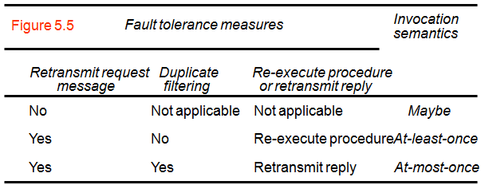
Combinations of these measures lead to a variety of possible semantics for the reliability of remote invocations.
Figure 5.5 shows the measures, with corresponding names for the invocation semantics that they produce.
Local invocations are executed exactly once
Remote invocations cannot achieve this.
The Request-reply protocol can apply fault-tolerance measure.

Slide 27
Invocation Semantics Properties
Maybe invocation semantics:
The remote method may be executed once or not at all
The invoker can not determine whether or not the remote method has been executed.
Types of failures:
Omission failures if the invocation or result message is lost.
Crash failures when the server containing the remote object fails.
Useful for applications where occasional failed invocation are acceptable.
Instructor’s Guide for Coulouris, Dollimore and Kindberg Distributed Systems: Concepts and Design Edn. 3 © Addison-Wesley Publishers 2000

Slide 28
Invocation Semantics Properties
At-least-once invocation semantics:
The invoker either receives a result (in which case the user knows the method was executed at least once) or an exception info that no result was received.
At-least-once invocation semantics can be achieved by retransmitting request mesz ,masks omission failures
Types of failures:
Crash failures when the server containing the remote object fails.
Arbitrary failure when the remote method is invoked more than once, wrong values are stored or returned. An idempotent operation that can be performed repeatedly with the same effect can be a solution.
Useful if the objects in a server can be designed to have idempotent operations.

Slide 29
At-most-once invocation semantics:
The invoker either receives a result (and the user knows the the method was executed exactly at most once) or an exception.
All fault tolerance methods executed.
Omission failures can be eliminated by retransmitting request.
Arbitrary failures can be prevented by ensuring that no method is executed more than once.
JAVA RMI and CORBA use at-most-once semantics. CORBA also maybe semantics for methods that do not return results. SUNRPC provides at-least-once semantics.
Instructor’s Guide for Coulouris, Dollimore and Kindberg Distributed Systems: Concepts and Design Edn. 3 © Addison-Wesley Publishers 2000

Slide 30
(Location) Transparency Issues
Goal is to make a remote invocation as similar as possible a local invocation.
All the necessary calls to marshaling and mesz passing procedures were hidden from the programer making the calls
The transparency had been applied to distributed objs but involves hiding not only marshaling and mesz passing but also task of locating and contacting a remote obj
Issues (Differences from the local invocation)
Syntax may be made identical but behavioral differences exists. The cause could be failure and latency.
Interface specification
Exceptions and exception handling are needed.
Different invocation semantics can be employed.

Slide 31
5.2.5 Implementation of RMI
Several separate objects and modules are involved.
Illustration: an application-level object A invokes a method in a remote application-level object B for which it holds a remote object reference.

Slide 32
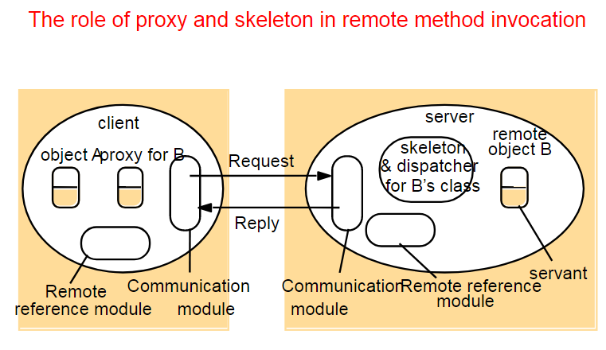
Implementation of RMI

Slide 33
Implementation of RMI
Communication module: The two cooperating communication modules carry out the request-reply protocol.
- This module uses only the first three items of the request- reply message : message type, requestId and object reference
- These modules are together responsible for providing a specified invocation semantics.
- The communication module in the server selects the dispatcher for the class of the object to be invoked, passing on its local reference,...

Slide 34
Implementation of RMI
Remote reference module: - is responsible for translating between local and remote object references and for creating remote object references.
- the remote reference module in each process has a remote object table that records the correspondence between local object references in that process and remote object references.

Slide 35
Implementation of RMI
The remote object table includes: -
An entry for all the remote objects held by the process. Ex: the remote object B will be recorded in the table at the server.
- An entry for each local proxy. Ex: the proxy for B will be recorded in the table at the client.

Slide 36
Implementation of RMI
Actions of the remote reference module:
When a remote object is to be passed as argument or result for the first time, the remote reference module is asked to create a remote object reference, which it adds to its table.
When a remote object reference arrives in a request or reply message, the remote reference module is asked for the corresponding local object reference.

Slide 37
Implementation of RMI
Servants:
It is an instance of a class which provides the body of a remote object.
- eventually handles the remote requests passed on by the corresponding skeleton.

Slide 38
Implementation of RMI
The RMI software: -
A layer of software between the application-level objects and the communication and remote reference modules.
- Roles of the middleware objects:
Proxy
Dispatcher
Skeleton

Slide 39
Implementation of RMI
Proxy:
- makes remote method invocation transparent to clients by behaving like a local object to the invoker.
- hides the details of the remote object reference, the marshalling of arguments, etc.
- There is one proxy for each remote object for which a process holds a remote object reference.

Slide 40
Implementation of RMI
Dispatcher:
- A server has one dispatcher and skeleton for each class representing a remote object.
- It receives the request message from the communication module, uses the methodld to select the appropriate method in the skeleton & passes on the request message.

Slide 41
Implementation of RMI
Skeleton:
- The class of a remote object has a skeleton, which implements the methods in the remote interface.
- A skeleton method unmarshals the arguments in the request message and invokes the corresponding method in the servant.
- It waits for the invocation to complete and then marshals the result, together with any exceptions, in a reply message to the sending proxy's method.

Slide 42
Implementation of RMI
The binder:
- a separate service that maintains a table containing mappings from textual names to remote object references.
- used by servers to register their remote objects by name & by clients to look them up.
Server threads:
- to avoid the execution of one remote invocation delaying the execution of another, servers generally allocate a separate thread for the execution or each remote invocation.

Slide 43
Implementation of RMI
Activation of remote objects:
- Some applications require that information survive for long periods of time...
- Servers that manage remote objects can be started whenever they are needed by clients.
- Processes that start server processes to host remote objects are called activators.

Slide 44
Implementation of RMI
A remote object is described as active when it is available for invocation within a running process, whereas it is called passive if is not currently active but can be made active.
A passive object consists of two parts:
the implementation of its methods;
and its state in the marshalled form.

Slide 45
Implementation of RMI
Activation
- create an active object from the corresponding passive object
- by creating a new instance of its class and initializing its instance variables from the stored state.
An activator is responsible for:
Registering passive objects that are available for activation
Starting named server processes and activating remote objects in them
Keeping track of the locations of the servers for remote objects that it has already activated

Slide 46
Implementation of RMI
Persistent object stores
- Persistent object: An object that is guaranteed to live between activations of processes.
- a persistent object store will manage very large numbers of persistent objects.
- Activation is normally transparent
- Persistent objects that are no longer needed in main memory can be passivated.

Slide 47
Implementation of RMI
Object location
- In the simple case, a remote object reference can act as an address...
- A location service helps clients to locate remote objects from their remote object references. It uses a database that maps remote object references to their current locations

Slide 48
5.2.6 Distributed garbage collection
- the aim is to ensure that if a local or remote reference to an object is still held anywhere, then the object will continue to exist.

Slide 49
5.2.6 Distributed garbage collection
Distributed garbage collection algorithm
- based on reference counting.
- whenever a remote object reference enters a process, a proxy will be created.
- the server should be informed of the new proxy at the client.
- later when there is no longer a proxy at the client, the server should be informed.

Slide 50
The distributed garbage collectors works in cooperation with the local garbage collector as follows
Each server process maintains a set of the names of the processes that hold remote object references for each of its remote objects; Ex: B.holders is the set of client processes that have proxies for object B.
When a client C first receives a remote reference to a particular remote object, B, it makes an addRef(B) invocation to the server of that remote object and then creates a proxy; the server adds C to B.holders.

Slide 51
When a client C's garbage collector notices that a proxy for remote object B is no longer reachable, it makes a removeRef(B) invocation to the corresponding server and then deletes the proxy; the server removes C from B.holders.
When B.holders is empty, the server's local garbage collector will reclaim the space occupied by B unless there are any local holders.

Slide 52
Instructor’s Guide for Coulouris, Dollimore and Kindberg Distributed Systems: Concepts and Design Edn. 3 © Addison-Wesley Publishers 2000

Slide 53
5.3 REMOTE PROCEDURE CALL
-A RPC is same like a RMI in that A client program calls a procedure in another program running in a server process.
- Servers may be clients of other servers to allow chains of RPCs.
- A server process defines in its service interface the procedures that are available for calling remotely.
- like RMI,RPC May be implemented to have one of the choices of invocation semantics.

Slide 54
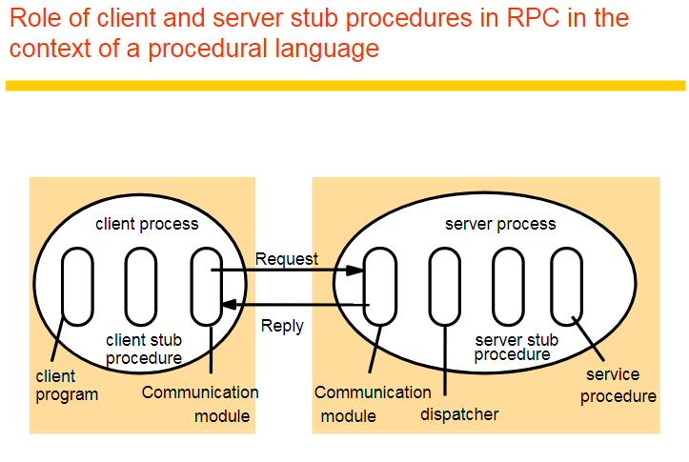

Slide 55
The software that supports RPC
- no remote reference modules are required.
- Client that accesses a service includes one stub procedure for each procedure in the service interface.
- Role of a stub procedure is similar to that of a proxy method.

Slide 56
- Server process contains a dispatcher together with one server stub procedure and one service procedure for each procedure in the service interface.
- The dispatcher selects one of the server stub procedures according to the procedure identifier in the request message.
- A server stub procedure is like a skeleton method.
- The service procedures implement the procedures in the service interface.

Slide 57
Sun RPC:CASE STUDY
It is designed for client-server communication over Sun NFS network file system.
UDP or TCP can be used. If UDP is used, the message length is restricted to 64 KB, but 8 - 9 KB in practice.
The Sun XDR is originally intended for external data representation.
Valid data types supported by XDR include int, unsigned int, long, structure, fixed array, string (null terminated char *), binary encoded data (for other data types such as lists).
Instructor’s Guide for Coulouris, Dollimore and Kindberg Distributed Systems: Concepts and Design Edn. 3 © Addison-Wesley Publishers 2000

Slide 58
Sun RPC:CASE STUDY
Interface Definition Language
The notation is rather primitive compared to CORBA IDL or JAVA as shown in Figure 5.8.
Instead of no interface definition, a program number and a version number are supplied.
The procedure number is used as a procedure definition.
Single input parameter and output result are being passed.
Instructor’s Guide for Coulouris, Dollimore and Kindberg Distributed Systems: Concepts and Design Edn. 3 © Addison-Wesley Publishers 2000

Slide 59
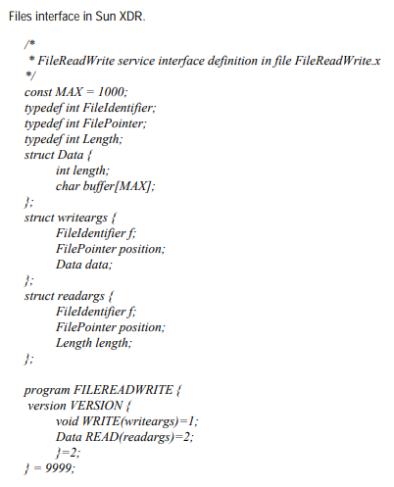
Figure 5.8 Files interface in Sun XDR

Slide 60
Sun RPC
The interface compiler rpcgen can be used to generate the following from interface definition.
client stub procedures
server main procedure, dispatcher and server stub procedures
XDR marshalling and unmarshalling procedures used by dispatcher and client, server stub procedures.
Binding:
portmapper records program number, version number, and port number.
If there are multiple instance running on different machines, clients make multicast remote procedure calls by broadcasting them to all the port mappers.
Instructor’s Guide for Coulouris, Dollimore and Kindberg Distributed Systems: Concepts and Design Edn. 3 © Addison-Wesley Publishers 2000

Slide 61
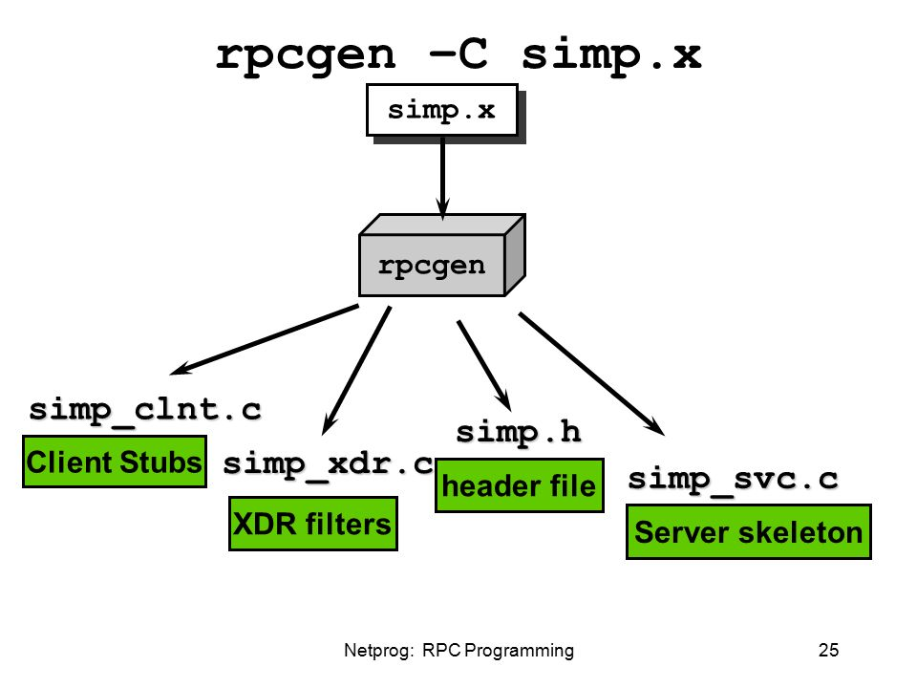
RPC Interface Compiler
Instructor’s Guide for Coulouris, Dollimore and Kindberg Distributed Systems: Concepts and Design Edn. 3 © Addison-Wesley Publishers 2000

Slide 62
Sun RPC
Authentication:
Additional fields are provided in the request-reply message.
Server program should check the authentication and then execute.
Different authentication protocols can be supported - none, UNIX style, shared key, Kerberos style.
A field in RPC header indicates which style is used.
Instructor’s Guide for Coulouris, Dollimore and Kindberg Distributed Systems: Concepts and Design Edn. 3 © Addison-Wesley Publishers 2000

Slide 63
Events and Notifications
The idea behind the use of events is that one object can react to a change occurring in another object.
The actions done by the user are seen as events that cause state changes in objects.
The objects are notified whenever the state changes.
Local event model can be extended to distributed event-based systems by using the publish-subscribe paradigm.
Instructor’s Guide for Coulouris, Dollimore and Kindberg Distributed Systems: Concepts and Design Edn. 3 © Addison-Wesley Publishers 2000

Slide 64
Events and Notifications
In publish-subscribe paradigm
An object that has event publishes.
Those that have interest subscribe.
Objects that represent events are called notifications.
Distributed event-based systems have two main characteristics:
Heterogeneous – Event-based systems can be used to connect heterogeneous components in the Internet.
Asynchronous – Notification are sent asynchronously by event-generating objects to those subscribers.
Instructor’s Guide for Coulouris, Dollimore and Kindberg Distributed Systems: Concepts and Design Edn. 3 © Addison-Wesley Publishers 2000

Slide 65
Events and Notifications
A dealing room system could be modeled by processes with two different tasks (Figure 5.9):
An information provider process continuously receives new trading information from a single external source and applies to the appropriate stock objects.
A dealer process creates an object to represent each named stock that the user asks to have displayed.
An event source can generate events of one more different types. Each event has attributes that specify information about that event.
Instructor’s Guide for Coulouris, Dollimore and Kindberg Distributed Systems: Concepts and Design Edn. 3 © Addison-Wesley Publishers 2000

Slide 66
Figure 5.9 Dealing room system
Dealer’s computer
External
Dealer’s computer
source
Dealer
Notification
Notification
Dealer
Notification
Information
provider
Notification
Notification
Notification
Notification
Dealer’s computer
Dealer’s computer
Notification
Information
provider
Notification
Dealer
Notification
Dealer
External
source
Instructor’s Guide for Coulouris, Dollimore and Kindberg Distributed Systems: Concepts and Design Edn. 3 © Addison-Wesley Publishers 2000

Slide 67
Events and Notifications
The architecture of distributed event notification specifies the roles of participants as in Fig. 5.10:
It is designed in a way that publishers work independently from subscribers.
Event service maintains a database of published events and of subscribers’ interests.
The roles of the participants are:
Object of Interest – This is an object experiences changes of state, as a result of its operations being invoked.
Instructor’s Guide for Coulouris, Dollimore and Kindberg Distributed Systems: Concepts and Design Edn. 3 © Addison-Wesley Publishers 2000

Slide 68
Events and Notifications
The roles of the participants are (continued):
Event – An event occurs at an object of interest as the result of the completion of a method invocation.
Notification – A notification is an object that contains information about an event.
Subscriber – A subscriber is an object that has subscribed to some type of events in another object.
Observer objects – The main purpose of an observer is to separate an object of interest from its subscribers.
Publisher – This is an object that declares that it will generate notifications of particular types of event.
Instructor’s Guide for Coulouris, Dollimore and Kindberg Distributed Systems: Concepts and Design Edn. 3 © Addison-Wesley Publishers 2000

Slide 69
Events and Notifications
Figure 5.10 shows three cases:
An object of interest inside the event service sends notification directly to the subscribers.
An object of interest inside the event service sends notification via the observer to the subscribers.
The observer queries the object of interest outside the event service and sends notifications to the subscribers.
Instructor’s Guide for Coulouris, Dollimore and Kindberg Distributed Systems: Concepts and Design Edn. 3 © Addison-Wesley Publishers 2000

Slide 70
Figure 5.10 Architecture for distributed event notification
Event service
object of interest
subscriber
1.
notification
object of interest
observer
subscriber
2.
notification
notification
object of interest
observer
subscriber
3.
notification
Instructor’s Guide for Coulouris, Dollimore and Kindberg Distributed Systems: Concepts and Design Edn. 3 © Addison-Wesley Publishers 2000

Slide 71
Events and Notifications
delivery semantics :A variety of delivery semantics can be employed: - the one that is chosen should depend on the requirements of applications
IP multicast protocol – information delivery on the latest state of a player in an Internet game
Reliable multicast protocol – information provider / dealer
Totally ordered multicast - Computer Supported Cooperative Working (CSCW) environment
Real-time – nuclear power station / hospital patient monitor
Instructor’s Guide for Coulouris, Dollimore and Kindberg Distributed Systems: Concepts and Design Edn. 3 © Addison-Wesley Publishers 2000

Slide 72
Events and Notifications
Roles for observers – the task of processing notifications can be divided among observers:
Forwarding – Observers simply forward notifications to subscribers.
Filtering of notifications – Observers address notifications to those subscribers who find these notifications are useful.
Patterns of events – Subscribers can specify patterns of events of interest.
Notification mailboxes – A subscriber can set up a notification mailbox which receives the notification on behalf of the subscriber.
Instructor’s Guide for Coulouris, Dollimore and Kindberg Distributed Systems: Concepts and Design Edn. 3 © Addison-Wesley Publishers 2000

Slide 73
Jini Distributed Event Specification:Case Study
Jini network technology is an open spontaneous network architecture that enables developers to create network-centric services - whether implemented in hardware or software - that are highly adaptive to change.
Jini’s distributed events specification allows a potential subscriber in one Java Virtual Machine(JVM) to subscribe to and receive notifications of events in an object of interest in another JVM.
Instructor’s Guide for Coulouris, Dollimore and Kindberg Distributed Systems: Concepts and Design Edn. 3 © Addison-Wesley Publishers 2000

Slide 74
Jini Distributed Event Specification
Main objects:
Event generators - It is an object that allows other objects to subscribe to its events and generates notifications.
Remote event listeners - A remote event listener is an object that can receive notifications.
Remote events - A remote event is an object that is passed by value to remote event listeners. It is equivalent to a notification.
Third party agents - Third party agents may be interposed between an object of interest and a subscriber.They are equivalent of observers
Instructor’s Guide for Coulouris, Dollimore and Kindberg Distributed Systems: Concepts and Design Edn. 3 © Addison-Wesley Publishers 2000

Slide 75
Interfaces and Classes
Jini events are provided by means of the following interfaces and classes:
RemoteEventListener - The RemoteEventListener interface needs to be implemented by any object that wants to receive a notification of a remote event from some other object.
RemoteEvent - The base class or superclass for remote events.
EventRegistration - A utility class for use as a return value for event-interest registration methods.
Instructor’s Guide for Coulouris, Dollimore and Kindberg Distributed Systems: Concepts and Design Edn. 3 © Addison-Wesley Publishers 2000

Slide 76
Java RMI:Case Study
Java RMI extends the Java object model to provide support for distributed objects in the Java language.
It allows objects to invoke methods on remote objects using the same syntax as for local invocations.
Type checking applies equally to remote invocations as to local ones.
The remote invocation is known because RemoteExceptions has been handled and the remote object is implemented using the Remote interface.
The semantics of parameter passing differ because invoker and target are remote from on another.
Instructor’s Guide for Coulouris, Dollimore and Kindberg Distributed Systems: Concepts and Design Edn. 3 © Addison-Wesley Publishers 2000

Slide 77
Java RMI
Programming distributed applications in Java RMI is simple.
It is a single-language system.
The programmer of a remote object must consider its behavior in a concurrent environment.
The files needed for creating a Java RMI application are:
A remote interface defines the remote interface provided by the service. Usually, it is a single line statement specifies the service function (HelloInterface.java). (An interface is the skeleton for a public class.)
Instructor’s Guide for Coulouris, Dollimore and Kindberg Distributed Systems: Concepts and Design Edn. 3 © Addison-Wesley Publishers 2000

Slide 78
Java RMI
The files needed for creating a Java RMI application are (continued):
A remote object implements the remote service. It contains a constructor and required functions. (Hello.java)
A client that invokes the remote method. (HelloClient.java)
The server offers the remote service, installs a security manager and contacts rmiregistry with an instance of the service under the name of the remote object. (HelloServer.java)
Instructor’s Guide for Coulouris, Dollimore and Kindberg Distributed Systems: Concepts and Design Edn. 3 © Addison-Wesley Publishers 2000

Slide 79
HelloInterface.java
import java.rmi.*;
public interface HelloInterface extends Remote {
public String say(String msg) throws RemoteException;
}
Instructor’s Guide for Coulouris, Dollimore and Kindberg Distributed Systems: Concepts and Design Edn. 3 © Addison-Wesley Publishers 2000

Slide 80
Hello.java
import java.rmi.*;
import java.rmi.server.*;
public class Hello extends
UnicastRemoteObject implements HelloInterface {
private String message;
public Hello(String msg) throws RemoteException {
message = msg;
}
Instructor’s Guide for Coulouris, Dollimore and Kindberg Distributed Systems: Concepts and Design Edn. 3 © Addison-Wesley Publishers 2000

Slide 81
Hello.java (continued)
public String say(String m) throws RemoteException {
// return input message - reversing input and suffixing
// our standard message
return new StringBuffer(m).reverse().toString() + "\n" + message;
}
}
Instructor’s Guide for Coulouris, Dollimore and Kindberg Distributed Systems: Concepts and Design Edn. 3 © Addison-Wesley Publishers 2000

Slide 82
HelloClient.java
import java.rmi.*;
public class HelloClient {
public static void main(String args[]) {
String path = "//localhost/Hello";
try {
if (args.length < 1) {
System.out.println("usage: java HelloClient <host:port> <string> ... \n");
} else path = "//" + args[0] + "/Hello";
Instructor’s Guide for Coulouris, Dollimore and Kindberg Distributed Systems: Concepts and Design Edn. 3 © Addison-Wesley Publishers 2000

Slide 83
HelloClient.java
HelloInterface hello =
(HelloInterface) Naming.lookup(path);
for (int i = 0; i < args.length; ++i)
System.out.println(hello.say(args[i]));
} catch(Exception e) {
System.out.println("HelloClient exception: " + e);
}
}
}
Instructor’s Guide for Coulouris, Dollimore and Kindberg Distributed Systems: Concepts and Design Edn. 3 © Addison-Wesley Publishers 2000

Slide 84
HelloServer.java
import java.rmi.*;
import java.rmi.server.*;
public class HelloServer {
public static void main(String args[]) {
// Create and install a security manager
if (System.getSecurityManager() == null)
System.setSecurityManager(new RMISecurityManager());
try {
Naming.rebind("Hello", new Hello("Hello, world!"));
System.out.println("server is running...");
}
Instructor’s Guide for Coulouris, Dollimore and Kindberg Distributed Systems: Concepts and Design Edn. 3 © Addison-Wesley Publishers 2000

Slide 85
HelloServer.java
catch (Exception e) {
System.out.println("Hello server failed:" + e.getMessage());
}
}
}
Instructor’s Guide for Coulouris, Dollimore and Kindberg Distributed Systems: Concepts and Design Edn. 3 © Addison-Wesley Publishers 2000

Slide 86
Java RMI
Compile the code
javac Hello.java HelloClient.java HelloInterface.java HelloServer.java
Generate stubs for the remote service (make sure that your classpath contains your current directory)
rmic Hello
Start the registry (in a separate window or in the background)
rmiregistry
(be sure to kill this process when you're done)
Instructor’s Guide for Coulouris, Dollimore and Kindberg Distributed Systems: Concepts and Design Edn. 3 © Addison-Wesley Publishers 2000

Slide 87
Java RMI
Start the server in one window or in the background with the security policy
java -Djava.security.policy=policy HelloServer
or without the security policy
java HelloServer
Run the client in another window
java HelloClient testing
Instructor’s Guide for Coulouris, Dollimore and Kindberg Distributed Systems: Concepts and Design Edn. 3 © Addison-Wesley Publishers 2000

Slide 88
Java RMI Remote Object References
An object must have the remote object reference of other object in order to do remote invocation of that object.
Parameter and result passing
Remote object references may be passed as input arguments or returned as output arguments.
Parameters of a method in Java are input parameters.
Returned result of a method in Java is the single output parameter.
Objects are serialized to be passed as parameters.
When a remote object reference is returned, it can be used to invoke remote methods.
Local serializable objects are copied by value.
Instructor’s Guide for Coulouris, Dollimore and Kindberg Distributed Systems: Concepts and Design Edn. 3 © Addison-Wesley Publishers 2000

Slide 89
Java RMI Remote Object References
Downloading of classes
Java is designed to allow classes to be downloaded from one virtual machine to another.
If the recipient of a remote object reference does not posses the proxy class, its code is downloaded automatically.
RMIregistry
The RMIregistry is designed to allow is the binder for Java RMI.
It maintains a table mapping textual, URL-style names to references to remote objects.
Instructor’s Guide for Coulouris, Dollimore and Kindberg Distributed Systems: Concepts and Design Edn. 3 © Addison-Wesley Publishers 2000

Slide 90
Java RMI Remote Object References
Server Program
The server consists of a main method and a servant class to implement each of its remote interface.
The main method of a server needs to create a security manager to enable Java security to apply the protection for an RMI server.
Client Program
Any client program needs to get started by using a binder to look up a remote reference.
A client can set a security manager and then looks up a remote object reference.
Instructor’s Guide for Coulouris, Dollimore and Kindberg Distributed Systems: Concepts and Design Edn. 3 © Addison-Wesley Publishers 2000

Slide 91
Java RMI Callbacks
Callback refers to server's action in notifying the client.
Callback Facility - Instead of client polling the server, the server calls a method in the client when it is updated.
Details
Client creates a remote object that implements an interface for the server to call.
The server provides an operation for clients to register their callbacks.
When an event occurs, the server calls the interested clients.
Instructor’s Guide for Coulouris, Dollimore and Kindberg Distributed Systems: Concepts and Design Edn. 3 © Addison-Wesley Publishers 2000

Slide 92
Java RMI Callback Issues
Advantages of callback
more efficient than polling
more timely than polling
provides a way for the server to inquire about client status
Disadvantages of callback
may leave server in inconsistent state if client crashes or exits without notifying server
requires server to make series of synchronous RMI's
Instructor’s Guide for Coulouris, Dollimore and Kindberg Distributed Systems: Concepts and Design Edn. 3 © Addison-Wesley Publishers 2000

Slide 93
Shared Whiteboard Example
In the RMI and CORBA case studies, we use a shared whiteboard as an example
This is a distributed program that allows a group of users to share a common view of a drawing surface containing graphical objects, each of which has been drawn by one of the users.
The server maintains the current state of a drawing and it provides operations for clients to:
Add a shape, retrieve a shape or retrieve all the shapes,
Retrieve its version number or the version number of a shape
•
Instructor’s Guide for Coulouris, Dollimore and Kindberg Distributed Systems: Concepts and Design Edn. 3 © Addison-Wesley Publishers 2000

Slide 94
Figure 5.11 Java Remote interfaces Shape and ShapeList
Note the interfaces and arguments
GraphicalObject is a class that implements Serializable.
Figure 5.11
import java.rmi.*;
import java.util.Vector;
public interface Shape extends Remote {
int getVersion() throws RemoteException;
GraphicalObject getAllState() throws RemoteException;
}
public interface ShapeList extends Remote {
Shape newShape(GraphicalObject g) throws RemoteException;
Vector allShapes() throws RemoteException;
int getVersion() throws RemoteException;
}
•
Instructor’s Guide for Coulouris, Dollimore and Kindberg Distributed Systems: Concepts and Design Edn. 3 © Addison-Wesley Publishers 2000

Slide 95
Figure 5.12 The Naming class of Java RMIregistry
void rebind (String name, Remote obj)
This method is used by a server to register the identifier of a remote object by name, as shown in Figure 15.13, line 3.
void bind (String name, Remote obj)
This method can alternatively be used by a server to register a remote object by name, but if the name is already bound to a remote object reference an exception is thrown.
void unbind (String name, Remote obj)
This method removes a binding.
Remote lookup(String name)
This method is used by clients to look up a remote object by name, as shown in Figure 15.15 line 1. A remote object reference is returned.
String [] list()
This method returns an array of Strings containing the names bound in the registry.
Instructor’s Guide for Coulouris, Dollimore and Kindberg Distributed Systems: Concepts and Design Edn. 3 © Addison-Wesley Publishers 2000

Slide 96
Figure 5.13 Java class ShapeListServer with main method
import java.rmi.*;
public class ShapeListServer{
public static void main(String args[]){
System.setSecurityManager(new RMISecurityManager());
try{
ShapeList aShapeList = new ShapeListServant(); 1
Naming.rebind("Shape List", aShapeList ); 2
System.out.println("ShapeList server ready");
}catch(Exception e) {
System.out.println("ShapeList server main " + e.getMessage());}
}
}
Instructor’s Guide for Coulouris, Dollimore and Kindberg Distributed Systems: Concepts and Design Edn. 3 © Addison-Wesley Publishers 2000

Slide 97
Figure 5.14 Java class ShapeListServant implements interface ShapeList
import java.rmi.*;
import java.rmi.server.UnicastRemoteObject;
import java.util.Vector;
public class ShapeListServant extends UnicastRemoteObject implements ShapeList {
private Vector theList; // contains the list of Shapes 1
private int version;
public ShapeListServant()throws RemoteException{...}
public Shape newShape(GraphicalObject g) throws RemoteException { 2
version++;
Shape s = new ShapeServant( g, version); 3
theList.addElement(s);
return s;
}
public Vector allShapes()throws RemoteException{...}
public int getVersion() throws RemoteException { ... }
}
Instructor’s Guide for Coulouris, Dollimore and Kindberg Distributed Systems: Concepts and Design Edn. 3 © Addison-Wesley Publishers 2000

Slide 98
Figure 5.15 Java client of ShapeList
import java.rmi.*;
import java.rmi.server.*;
import java.util.Vector;
public class ShapeListClient{
public static void main(String args[]){
System.setSecurityManager(new RMISecurityManager());
ShapeList aShapeList = null;
try{
aShapeList = (ShapeList) Naming.lookup("//bruno.ShapeList") ; 1
Vector sList = aShapeList.allShapes(); 2
} catch(RemoteException e) {System.out.println(e.getMessage());
}catch(Exception e) {System.out.println("Client: " + e.getMessage());}
}
}
Instructor’s Guide for Coulouris, Dollimore and Kindberg Distributed Systems: Concepts and Design Edn. 3 © Addison-Wesley Publishers 2000

Slide 99
Figure 5.16 Classes supporting Java RMI
RemoteObject
RemoteServer
Activatable
UnicastRemoteObject
<servant class>
Instructor’s Guide for Coulouris, Dollimore and Kindberg Distributed Systems: Concepts and Design Edn. 3 © Addison-Wesley Publishers 2000

Slide 100
RMI Summary
Each object has a (global) remote object reference and a remote interface that specifies which of its operations can be invoked remotely.
Local method invocations provide exactly-once semantics; the best RMI can guarantee is at-most-once.
Middleware components (proxies, skeletons and dispatchers) hide details of marshalling, message passing and object location from programmers.
•
Instructor’s Guide for Coulouris, Dollimore and Kindberg Distributed Systems: Concepts and Design Edn. 3 © Addison-Wesley Publishers 2000

